Slide 1
Quiz Application
Presented
By
Diya Raina(2210990304)
Khushi Jamloki(2210990513)
Divanshu Kaushik(2210990290)
Under the supervision of
Mr. Vikas Patel
Ms. Parul Gahelot
Chitkara Institute of Engineering & Technology
Chitkara University, Punjab

Slide 2
Introduction
Development of online quiz app with diverse question types, scoring, and timer
Aim to engage users, enhance learning, and promote interactive engagement
Incorporation of multiple question formats and time constraints to challenge users
Integration of scoring system to add competitive element and foster achievement
Overall goal: Create immersive, educational experience for wide audience seeking entertainment and intellectual stimulation

Slide 3
Motivation of Research
The motivation behind this research and development stems from the desire to create an interactive and engaging learning tool.
Interactive quizzes have proven to be effective in promoting active learning and knowledge retention.
The application aims to provide a user-friendly and responsive design to cater to diverse learning preferences and devices.

Slide 4

Tools & Technologies
HTML/CSS: For structuring and styling the webpage, ensuring a visually appealing and user-friendly interface.
JavaScript: Implemented for dynamic behavior , functionality and updating content in real-time.
Bootstrap: Utilized for responsive design elements, ensuring compatibility across various devices and screen sizes.
DOM(Document Object Model) : structure of a document as a tree of objects where each object represents a part of the document. These objects can be manipulated programmatically to change the content, structure, and style of a web page

Slide 5
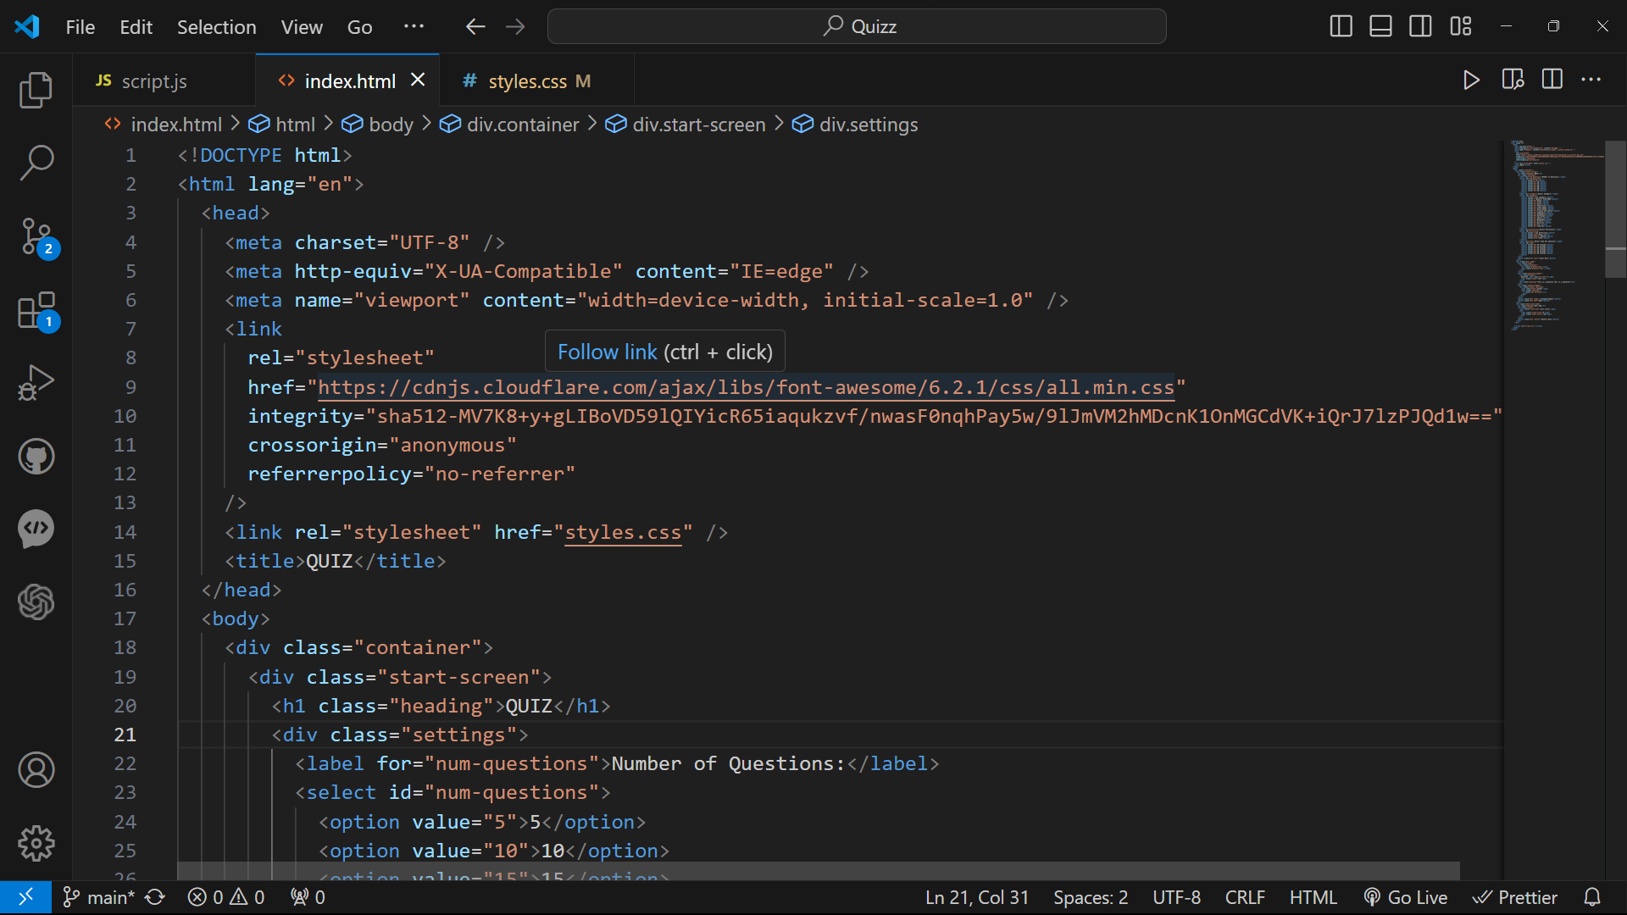
Code Snapshots
Index.html:-

Slide 6
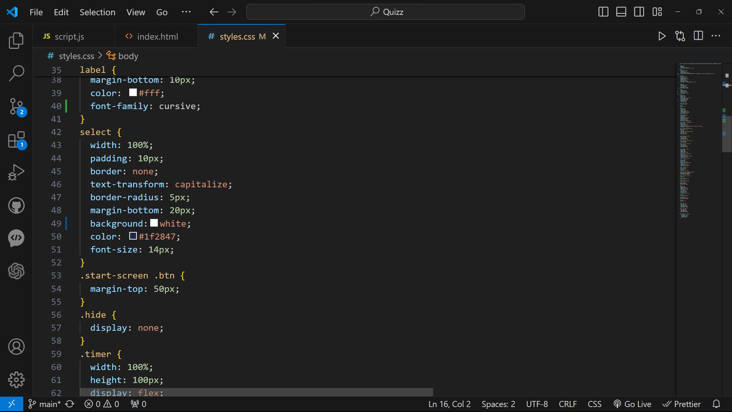
Code Snapshots
Styles.css:-

Slide 7
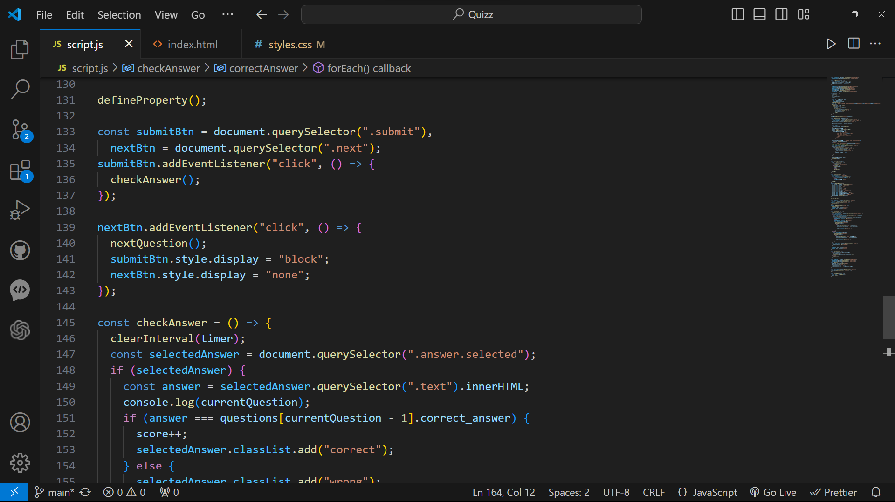
Code Snapshots
Script.js:-

Slide 8
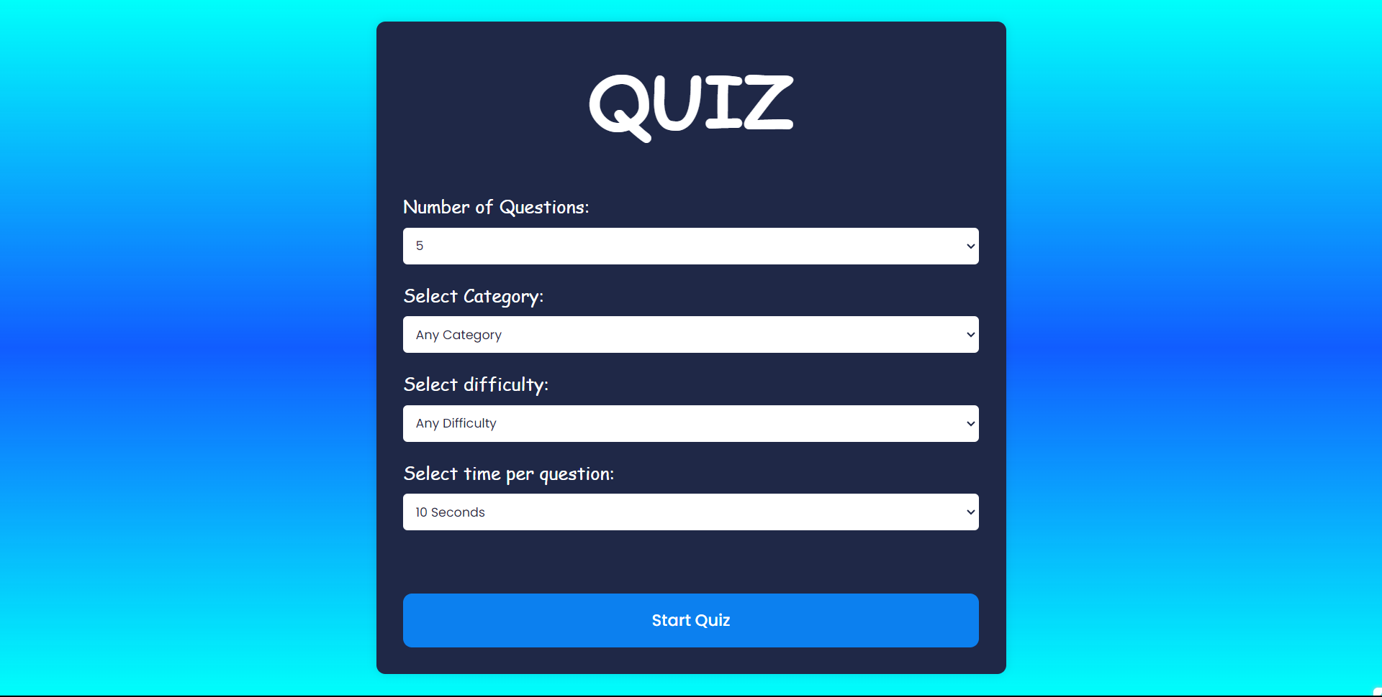
Home Page

Slide 9
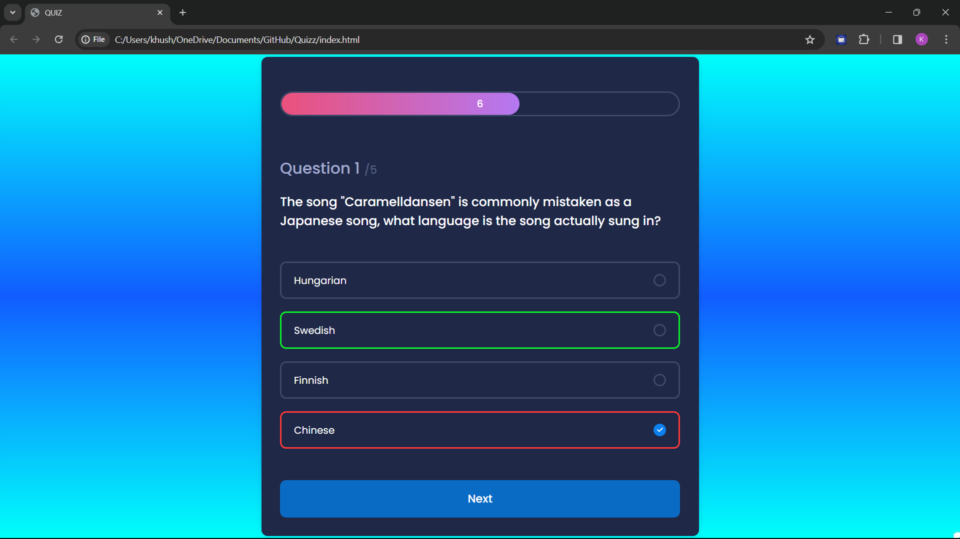
Snapshot

Slide 10
Conclusion/Theme Plan
Conclusion:
The amalgamation of HTML, CSS, and JavaScript has yielded a proficient and visually captivating quiz application. Its functionality and aesthetic appeal showcase meticulous design and coding efforts, resulting in a user-friendly experience. As we look ahead, our commitment to continuous improvement remains steadfast, aiming to deliver an engaging platform for knowledge testing and learning enhancement.
Theme Plan:
Reflecting on the achieved functionality and design, future plans include exploring diverse themes to cater to various user preferences. By offering a selection of themes or customizable options, we aim to enhance user engagement and satisfaction. This expansion will provide users with a personalized experience, further enriching their interaction with the quiz application. Additionally, these themes will contribute to the overall aesthetic diversity, ensuring the application appeals to a broader audience.

Slide 11
References
https://www.w3schools.com/js/js_htmldom.asp
https://www.geeksforgeeks.org/dom-document-object-model/
3. https://youtu.be/PBcqGxrr9g8si=9kJsh0JQ59vW0g
4. https://www.freecodecamp.org/news/an-introduction-to-the-javascript-dom-512463dd62ec/

Slide 12
Thank You

